Slide 1


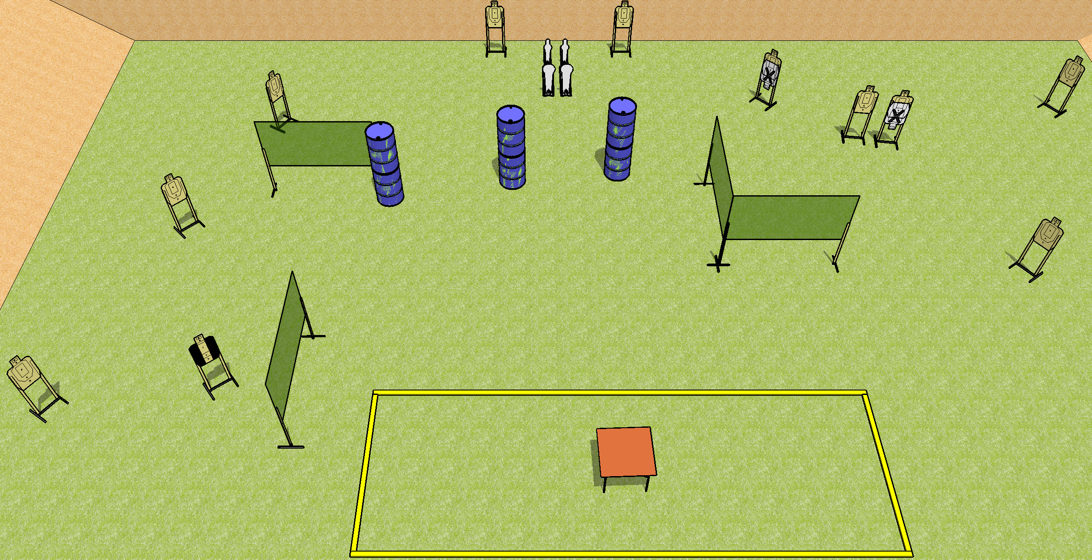
 | Dothan Gun Club – USPSA Match Table Angles Course Designer : Drew Coleman Bay: B2
Round Count 26 rounds 11 USPSA 2 colt poppers, 2 minis
Equipment List 7 wall feet Table 1 tux 12 targets (10 + 2 NS)

Slide 2
Table Angles
Written Stage Briefing
Scoring: Comstock Rounds: 26
Targets: 11 USPSA, 4 steel
Start position: anywhere inside the shooting area, wrists above shoulders. Firearm and first magazine is on table, unloaded, unpropped.
Stage Procedure: On the audible start signal, engage targets as they become available from within the shooting area.

